Slide 1


INTERNSHIP REPORT
Python Developer Intern
MD ARIF HUSSAIN
Codec Technologies Pvt. Ltd.
30 July 2026 – 02 September 2026
AICTE & ICAC Approved Internship Program

Slide 2




PROGRAM OVERVIEW
About the Internship
A structured, industry-aligned internship undertaken with Codec Technologies Pvt. Ltd., designed to build practical Python development capability under an AICTE & ICAC approved framework.
DURATION
APPROVAL
ROLE
ORGANIZATION
1 Month
AICTE & ICAC
Python Developer Intern
Codec Technologies Pvt. Ltd.
PYTHON DEVELOPER INTERNSHIP • CODEC TECHNOLOGIES
02

Slide 3




GOALS OF THE PROGRAM
Internship Objectives
Practical Python Exposure
Programming & Problem-Solving
Understand Python programming through hands-on, real-world practice rather than theory alone.
Develop stronger programming logic and structured problem-solving skills.
Project Structure Awareness
Applying Classroom Knowledge
Learn how software development projects are planned, organized and executed.
Translate theoretical academic concepts into practical, task-based application.
PYTHON DEVELOPER INTERNSHIP • CODEC TECHNOLOGIES
03

Slide 4


TECHNICAL TOOLKIT
Technologies & Skills
Core technical areas applied and strengthened during the internship.
Python
Programming
Fundamentals
Problem
Solving
Debugging
Software Dev.
Concepts
PYTHON DEVELOPER INTERNSHIP • CODEC TECHNOLOGIES
04

Slide 5

ON-THE-JOB LEARNING
Work & Learning Experience
Writing & Understanding Python Programs
Building fluency by writing, reading and interpreting Python code.
Programming-Related Tasks
Hands-on with
Python Development
Working through assigned tasks that applied core programming concepts.
Throughout the internship, practical exposure was gained by working directly with Python in a professional, task-driven environment.
Debugging & Improving Code
Identifying issues in code and refining logic for better outcomes.
Professional & Technical Growth
Building workplace discipline alongside technical ability.
PYTHON DEVELOPER INTERNSHIP • CODEC TECHNOLOGIES
05

Slide 6
RESULTS OF THE INTERNSHIP
Key Learning Outcomes
Improved Python Programming Knowledge
Better Logical & Problem-Solving Ability
Practical Understanding of Software Development
Improved Debugging Skills
Better Understanding of Professional Work Practices
PYTHON DEVELOPER INTERNSHIP • CODEC TECHNOLOGIES
06

Slide 7

Achievement
Successfully completed the 1 Month AICTE & ICAC Approved Internship
Program as a Python Developer Intern.
INTERNSHIP PERIOD: 30/07/2026 – 02/09/2026
Codec Technologies Pvt. Ltd. • AICTE ID: CORPORATE6759d549ce59e1733940553

Slide 8
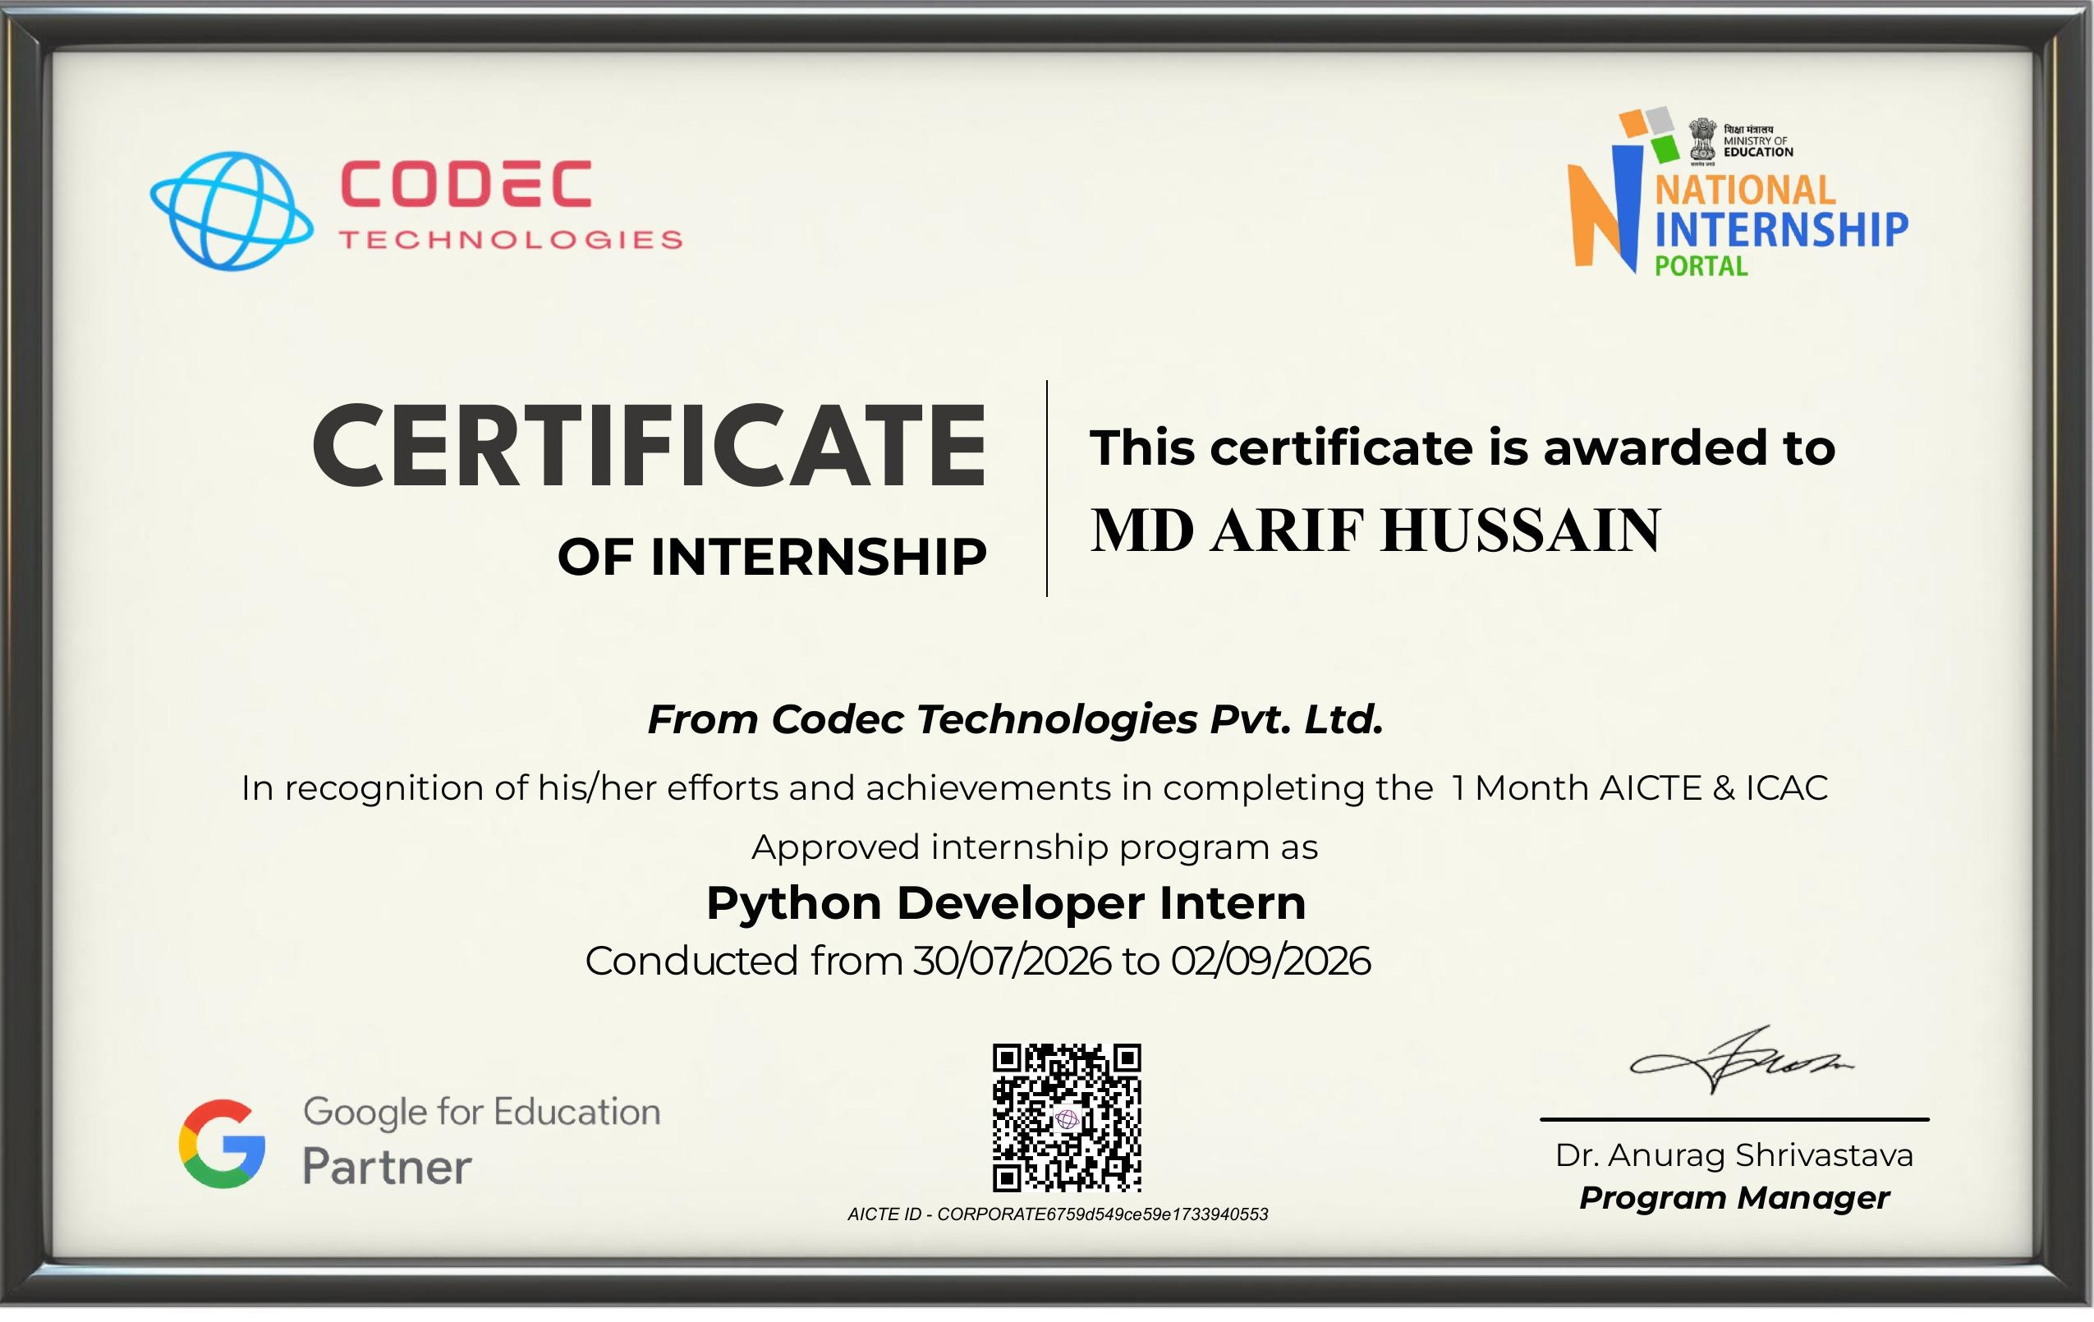
VERIFIED COMPLETION
Certificate & Thank You
Codec Technologies Pvt. Ltd.
Host Organization
Dr. Anurag Shrivastava
Program Manager
Thank You
MD ARIF HUSSAIN
08

